Slide 1

Lecture 9
Product Strategy, Branding and Product Management

Slide 2
Product Planning: Develop Product Objectives & Product Strategy
What makes one product succeed while another fails?
Effective product planning is guided by a continuous process of product management.
A systematic and usually team-based approach to coordinating all aspects of a product’s strategy development and execution

Slide 3
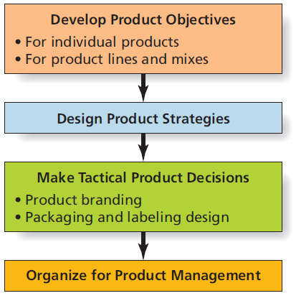
Steps to Manage Products

Slide 4
Getting Product Objectives Right
Clearly stated product objectives provide focus and direction.
Should support broader marketing objectives of business unit
Should be consistent with the firm’s overall mission
To be effective, objectives must be:
Measureable
Clear
Realistic
Indicate a specific time frame

Slide 5
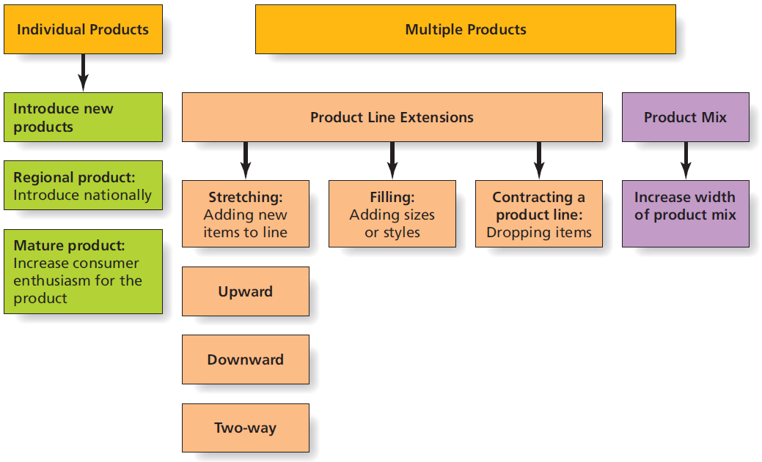
Objectives for Single and Multiple Products

Slide 6
Objectives and Strategies for Individual Products
Objectives and strategies for individual products:
Successful introduction of new products
Taking regional product nationwide
Breathing new life into mature products while maintaining a distinct brand personality

Slide 7
Objectives and Strategies for Multiple Products
A product line is the firm’s total product offering designed to satisfy a single need or desire of target customers.
Product line length is determined by the number of stock keeping units (SKUs).
Product line strategies:
Full-line vs. limited-line strategies
Upward, downward, or two-way line stretch
Filling out or contracting a product line
Cannibalization is a risk

Slide 8
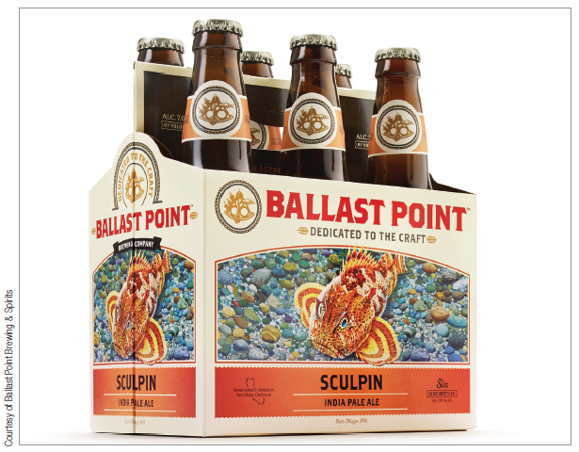
Product Mix Strategies
A product mix is the total set of products a firm offers for sale.
Product mix strategies
Width of product mix must be considered.
Product lines in mix usually have some things in common.

Slide 9
Ethical/Sustainable Decisions in the Real World
Kimberly Clark made great strides toward going green but how green is green enough?
“Huggies Pure and Natural” diapers are a “super-premium diaper that includes natural and organic materials and ingredients to provide gentle protection for new babies, as well as initial steps toward environmental improvements without sacrificing performance.”
Should marketers be allowed to promote a product to consumers as “green” or “natural” if they know that such claims are only partially accurate?

Slide 10
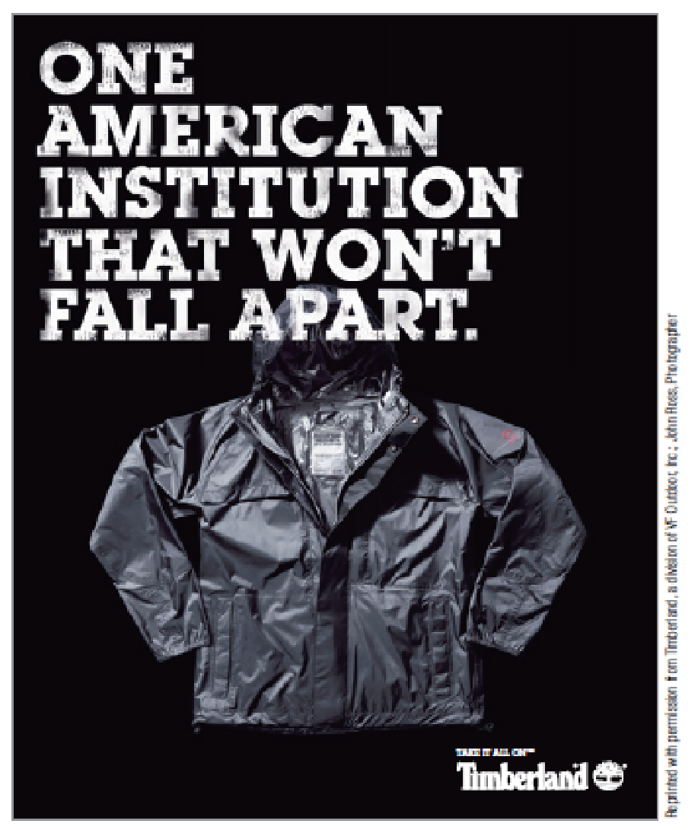
Quality as a Product Objective: TQM and Beyond
Product quality is often a key objective.
A philosophy of total quality management (TQM) can help companies achieve quality objectives.
Notes:
TQM is defined as company-wide dedication to the development, maintenance, and continuous improvement of all aspects of the company’s operations. As such, it promotes the attitude among employees that everyone serves customers and that their job is to maximize customer satisfaction, both internally, among employees (internal customers), and externally among those who buy the product.
Uniform ISO quality standards exist to offer guidance.

Slide 11
Quality Guidelines
ISO 9000
Standards for quality management
ISO 14000
Standards for environmental management
Six Sigma methodology
Process allows no more than 3.4 defects per million units (getting it right 99.997% of the time)

Slide 12
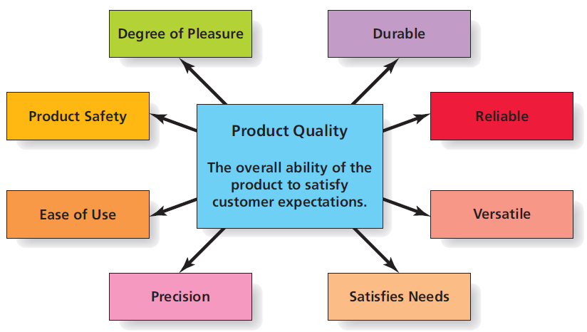
Product Quality

Slide 13
Use Product Objectives to Decide on a Product Strategy
Product management systematically guides product strategy development and execution.
Process begins with clear product objectives.
Objective setting underlies product line/mix decisions and quality management efforts.
How can you apply criteria for effective objective setting to attainment of your personal career and educational goals?

Slide 14

Marketing throughout the Product Life Cycle
Many products have long lives, while others are fads that are “here today, and gone tomorrow.”
The product life cycle (PLC) is a useful way to explain how market response and marketing activities change over the life of a product.

Slide 15
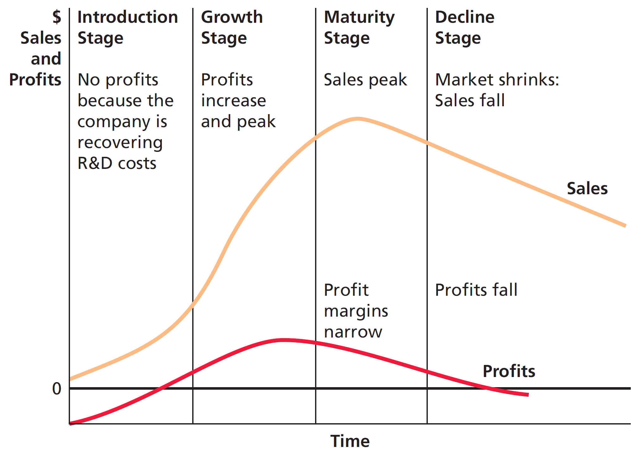
The Product Life Cycle

Slide 16
Introduction Phase of PLC
New products that are offshoots of well-known brands have an advantage.
Many products never make it out of the introduction phase due to low awareness.
As many as 95% of new products ultimately fail!
Effective advertising and promotion is essential.
Notes:
Introduction stage:
Slow growth occurs for newly introduced product as the company’s key objective is to get first-time buyers to try product.
The firm does not usually make a profit during this stage. A great deal of money is spent on marketing communications which create awareness for the product and where it can be found. The initial pricing strategy may set a high price more quickly to recover R&D expenditures, or a low price to encourage greater sales and market penetration.
It’s impossible to know how long any product will spend in the introduction or any other stage of the product life cycle. The product characteristics discussed in the previous chapter (relative advantage, complexity, compatibility, etc.) influence the rate of adoption. Also, the amount of money that a manufacturer is willing to invest in the product’s start-up can shorten or prolong the introduction stage. And of course, unfortunately, many products never make it out of the introduction, and lack of a budget for marketing communications is often the problem.

Slide 17
Growth, Maturity, and Decline Stages of the PLC
Growth stage of the PLC
The product is accepted and sales rapidly increase.
Maturity stage of the PLC
Typically longest phase
Sales peak while profit margins narrow.
Decline stage of the PLC
Sales decrease as customer needs change.
Notes:
Growth stage of the PLC:
The product is accepted by the marketplace, and sales increase rapidly during the growth stage of the PLC. Marketers’ key objective is to encourage brand loyalty by convincing consumers of the brand’s superiority. Firms often introduce product variations to attract market segments with different needs and to increase market share. Advertising and sales promotions are especially important to this phase of the life cycle, and price competition may begin to develop between different brands.
Maturity phase of the PLC:
For brands that make it past introduction, maturity is usually the longest phase of the PLC. Sales are at their peak, but the high level of competition often results in price competition and frequent sales promotion, which narrow profit margins. Firms monitor consumer trends and adapt existing products, or bring out new variants, to keep pace with changing consumer needs. Other aspects of the marketing mix may be altered as well.
Decline phase of the PLC:
A steady decrease in sales and profits characterizes the decline phase of the PLC. Often the root cause of declining sales is product obsolescence forced by new technology, or a radical change in consumer needs. The goal of the firm is to remain profitable, and marketers typically must decide whether to stay in the game or phase out a product. A phase out can occur in stages until existing inventory runs out, or the firm can have a fire sale and dump inventory immediately. Firms that decide to keep a product in decline attempt to maximize their profit by minimizing costs: very little investment in advertising or other forms of marketing communications are undertaken. The e-commerce marketplace has extended the life of many products that would have otherwise died without advertising support.

Slide 18
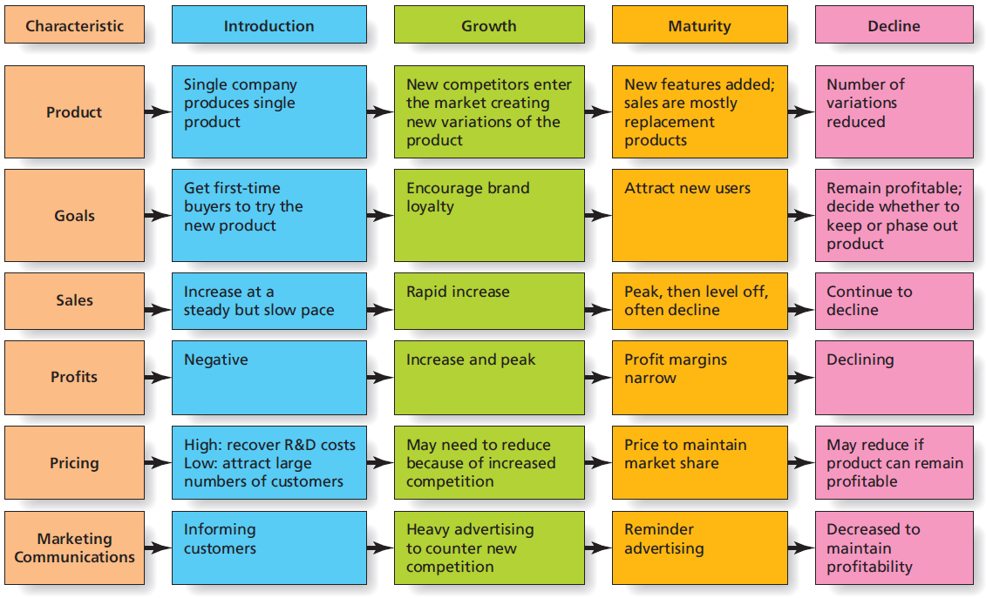
Marketing Mix Strategies throughout the Product Life Cycle

Slide 19
Product Life Cycles Phases
Up to 95% of new products ultimately fail. What are some implications of this statistic for marketers?

Slide 20
Branding and Packaging: Create Product Identity
What do you think of when you hear the word “Disney?”
Disney achieved its strong identity through decades of great branding.

Slide 21
What’s in a Name (or a Symbol)?
A “good” brand name:
maintains relationships with customers.
positions a product by: (1) portraying an image or (2) describing how the product works.
is easy to say, spell, read, and remember.
fits the target market, product benefits, customer’s culture, and legal requirements.

Slide 22
Trademarks
Trademark is the legal term for a brand name, brand mark, or trade character.
Trademarks legally registered by a government obtain protection for exclusive use in that country.
® is the trademark symbol used in the U.S.
Common-law protection
Visit the U.S. Patent and Trademark Office (USPTO)

Slide 23
Why Brands Matter
A brand is a lot more than just the product it represents.
Strong brands build emotional connections with customers.
Brand equity refers to a brand’s value to its organization over and above the value of the generic version of the product.
Brand equity provides competitive advantage.
Brand equity results in brand loyal consumers and attachment.

Slide 24
Brand Meaning
Strong brands forge lasting bonds with customers based on brand meaning.
Brand meaning encompasses the beliefs and associations a consumer has about the brand.
Today, brand meaning builds virally as people spread its story online.
Through brand storytelling, marketers seek to engage consumers with compelling stories about brands.
Notes:
When Disney decided to expand their movies beyond those targeting young children, they realized the importance of creating a sub-brand that could be marketed separately from existing Disney films, and the Touchstone film brand was born. Touchstone films are targeted at older audiences and often feature more adult content in terms of language and sexual situations that is not appropriate for young children.

Slide 25
Characteristics of World Class Brands
The brand excels at delivering the benefits customers desire.
The brand stays relevant.
The pricing strategy is based on consumer’s perceptions of value.
The brand is properly positioned.
The brand is consistent.
The brand portfolio and hierarchy make sense.
The brand coordinates a full repertoire of marketing activities to build equity.
The brand’s managers understand what the brand means to consumers.
The brand is given proper support.
The company monitors sources of equity.

Slide 26
Brand Extensions and Sub-Branding
Products with strong brand equity provide exciting opportunities for marketers.
Brand extensions arise from a firm leveraging brand equity to sell new products using the same brand name.
Sub-branding occurs when a firm creates a secondary brand to help differentiate a product line (e.g., Virgin Mobile, Virgin Atlantic, Virgin Galactic).

Slide 27
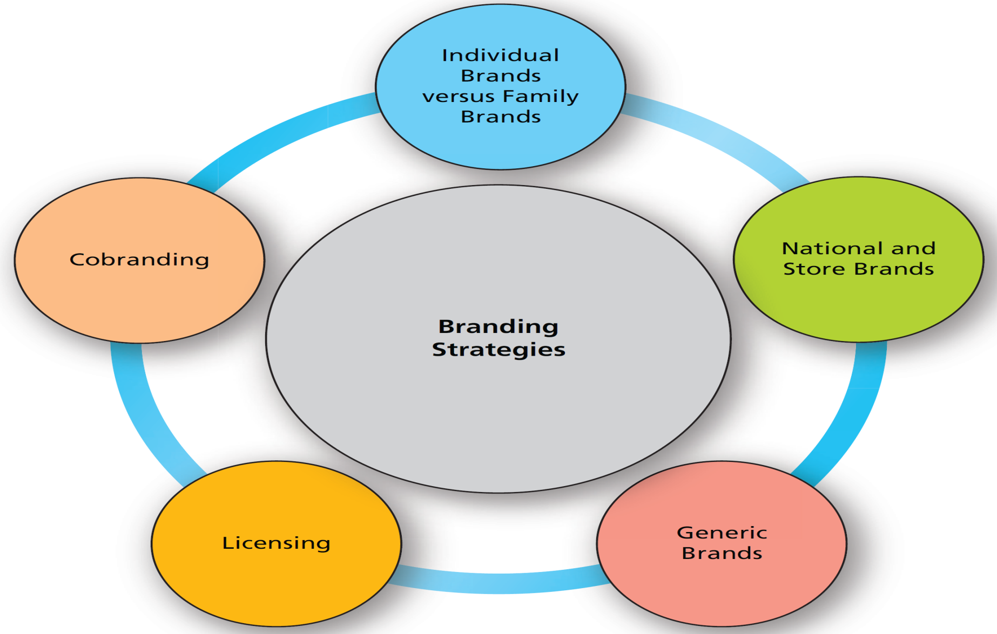
Branding Strategies

Slide 28
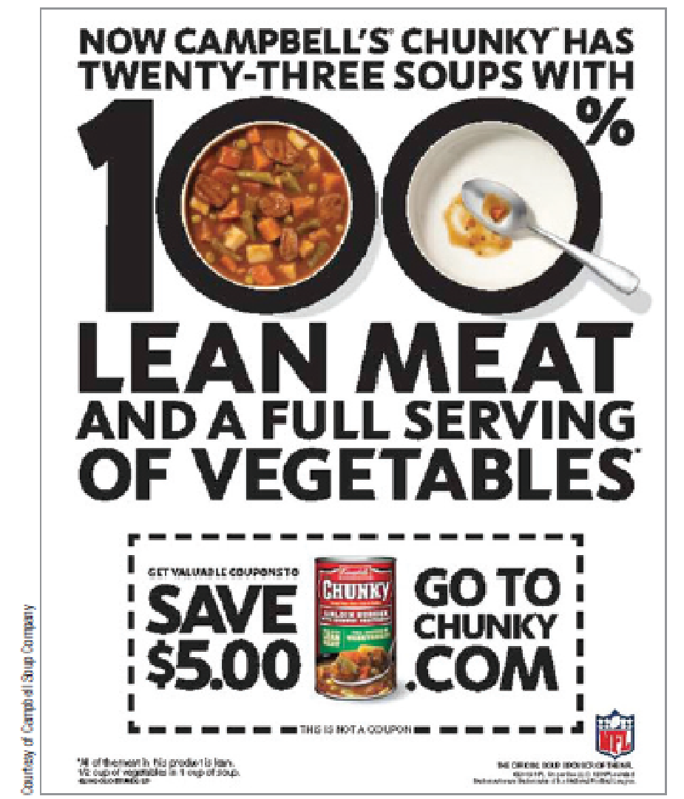
Individual vs. Family Brands
Family brand strategy is when product items share a common brand name.
Family brands such as Campbell’s provides an umbrella under which multiple products can be effectively marketed.

Slide 29
National and Store Brands
National brands are those produced and marketed by a manufacturer.
Store (or private label) brands are those which are offered by a retail store or chain under an exclusive trade name.
Costco: Kirkland’s
Wal-Mart: Sam’s Choice, Equate, Great Value, Mainstays
Others?

Slide 30
Generic Brands
Generic brands is a strategy in which products are not branded and are sold at lowest price possible.
Typically packaged in white with black letters that only names the product itself (“Green Beans”)
Generic branded products have fallen out of favor over the years, but prior to the introduction of store brands, generic products presented a low-cost alternative to national brands.
They are a legitimate alternative to both national and store brands, particularly for price-conscious consumers and during uncertain economic times.

Slide 31
Licensing
Licensing is when one firm sells to another firm the right to use a brand name for a specific purpose for a specific period of time.
The firm buying the licensing rights gains instant recognition and a short cut to building brand equity.
For instance, TGI Fridays licensed Jack Daniels “bourbon” name for use in many of its menu items. Also, movies typically offer licensing agreements to outside firms, such as toy manufacturers, amusement parks, and clothing companies.

Slide 32
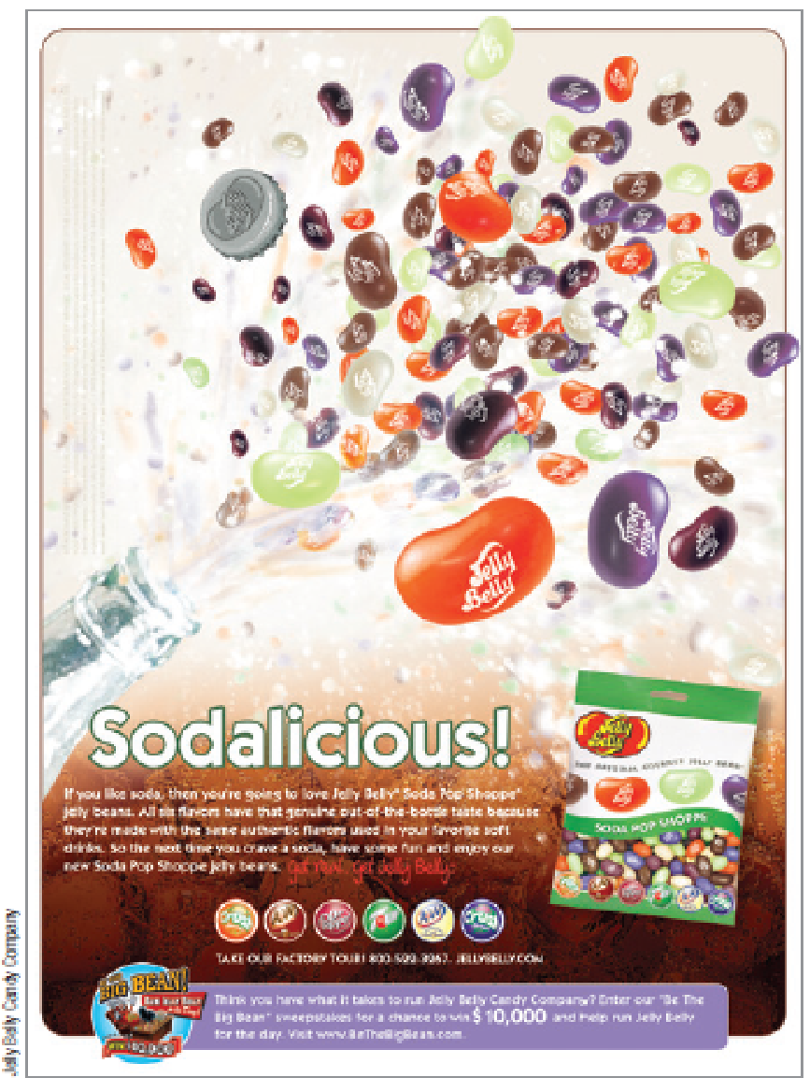
Cobranding
Cobranding: Two brands agree to work together to market a new product
Ingredient branding: Branded materials become “component parts” of other branded products.

Slide 33
Packages and Labels: Branding’s Little Helpers
A package is the covering or container for a product.
Serves both functional and communication purposes
Branding
UPC codes (Universal Product Code)

Slide 34
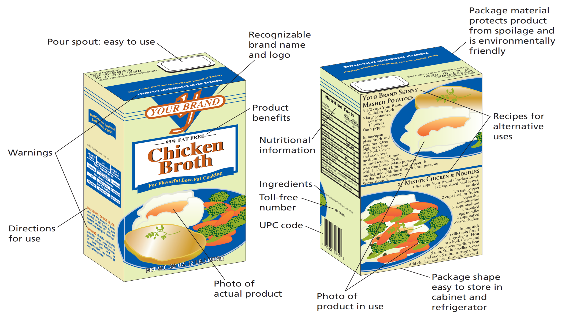
Functions of Packaging

Slide 35
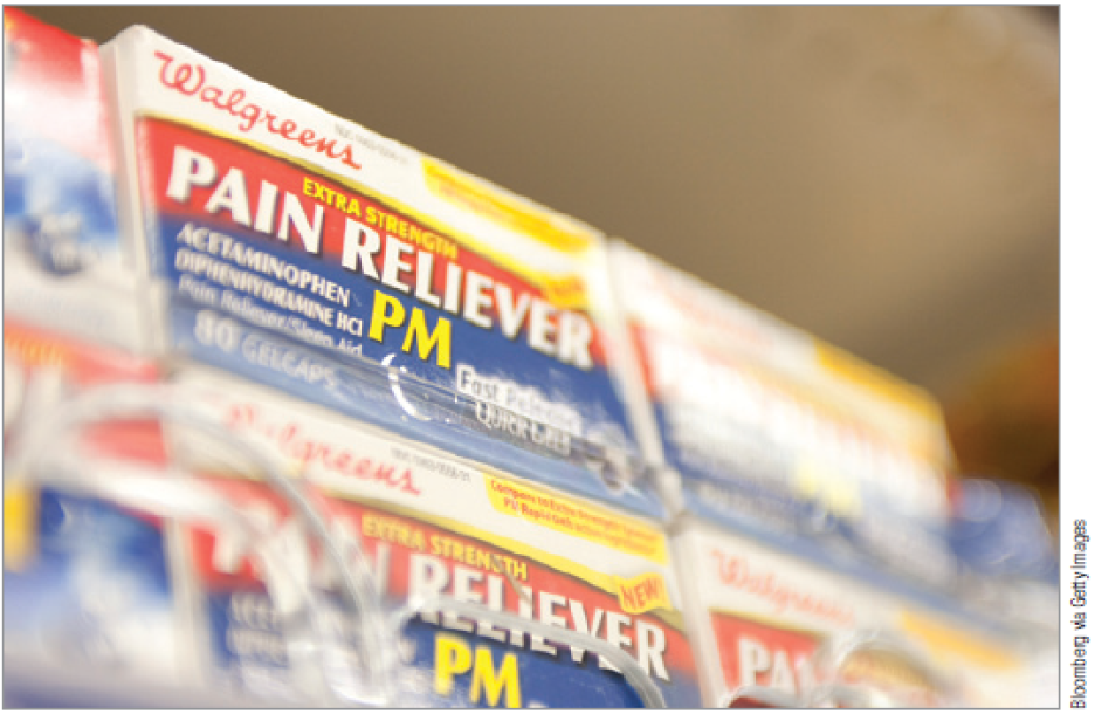
Design Effective Packaging
Effective packaging design entails many decisions
How are other products in category packaged and displayed?
Copycat packaging
Notes:
Some store brands opt for copycat packaging, mimicking the look of the national branded product they want to knock off.
Walgreen’s is a master of such copycat packaging—look on any shelf in its medicinal categories and you will see a Walgreen’s brand proudly merchandised on the shelf right next to the leading national brand in that category, with the package design and colors so similar that you have to look carefully to discern what you are actually buying.

Slide 36
Design Effective Packaging
Effective packaging also considers:
Choice of packaging material and the image it projects
Environmental impact of packaging
Shape and color influences on image
Graphic information to be portrayed
Many marketers use the VIEW model to evaluate the resulting package
Notes:
In addition to the packaging of other brands in the same product category, marketers must consider the choice of packaging material, and evaluate it with respect to the image that material projects. For example, plastic is often perceived as cheap—not the best packaging choice for a brand attempting to establish an elite brand image.
As sustainability becomes more important to both consumers and the corporate world, the environmental impact of different packaging choices will become increasingly important. Is the package made of recycled materials? Is it biodegradable? Does it use less packaging materials? Of course the environmental impact must be balanced against consumer needs and desires. As the text mentions, refill pouches had a relatively short life, as the majority of consumers didn’t like having to transfer the refill liquid into the existing spray bottle or container.
The shape and colors used on the package can be very helpful in creating brand meaning. Curved shapes are feminine, square and angular shapes are masculine. White communicates purity, while green is associated with health, vegetables, and a minty flavor.
Graphics can be used to show the results of using the product, the type of person who should be purchasing the product, or the product itself.
VIEW is an acronym which stands for the four basis elements of the model:
V = Visibility: the package’s ability to stand out on the shelf and to attractive attention. Visibility is somewhat dependent upon the brands that the product is placed next to on the shelf.
I = Information: the presence or absence of warnings, directions, nutritional information, product information, UPC code, recipes, or any other written information.
E = Emotional appeal: Similar to brand names, product packages have the ability to function as perceptual or surrogate cues in that they may suggest that specific attributes or benefits are provided by the brand. Color, in particular, is helpful in this regard. Reflective gold and silver colorings create a prestigious look for the brand; green connotes healthiness and is often used in food packaging; red is a color that can be associated with romance, spiciness, or certain flavors (strawberry, tomato, etc.). Other package elements contribute to a product’s emotional appeal as well. Curved packaging, such as perfume bottles, are feminine in nature. Wooden packaging materials (cologne stoppers, for example), are more masculine in nature.
W = Workability: Workability from the perspective of the retailer details issues such as whether the package fits easily onto the retail shelf and whether multiple units can be stacked upon one another, as well as whether the package actually protects the product. Workability from the customer viewpoint relates to whether the package will fit in cabinets or in the refrigerator (the 3-liter Coke failed for this reason), and whether it is easy to use (wine in a box comes with a spigot; plastic juice containers are safer for children to use; Ziploc linings in everything from cereal to hotdogs keep products fresh longer).

Slide 37
Branding and Packaging
Branding and packaging decisions play an essential role in shaping how consumers view a product.
While there are many types of decisions to be made, each should conform with the overall product strategy and needs of target markets.
Is it fair for retailers like Walgreens and Wal-Mart to use copycat packaging on store branded products?

